Slide 1
Syllabus
Applied Multivariate Statistical Analysis & SAS Software
Spring 2015

Slide 2
General Information
Instructor: Ph. D. & Prof. Nanxin Xia(夏南新)
Gender: Male
Working Dept.: Dept. of Economics
Lingnan College Sun Yat-sen University
Time: Spring Semester 2015
Wednesday at 8:00-9:40 a.m.
Classroom: Ye 103, Guangzhou Campus
E-mail: xianx@mail.sysu.edu.cn
Tel.: (020) 84110677(O)
Office hour: Wednesday at 9:40-11:40 a.m.
Office: 4thF Lingnan Administration Building
Tutor’s name: Zhewen Pan(潘哲文)

Slide 3
Tutorial Information
Zhewen Pan(潘哲文)
Tutor’s phone: 13416167301
Tutor’s email: panzhew@mail2.sysu.edu.cn

Slide 4
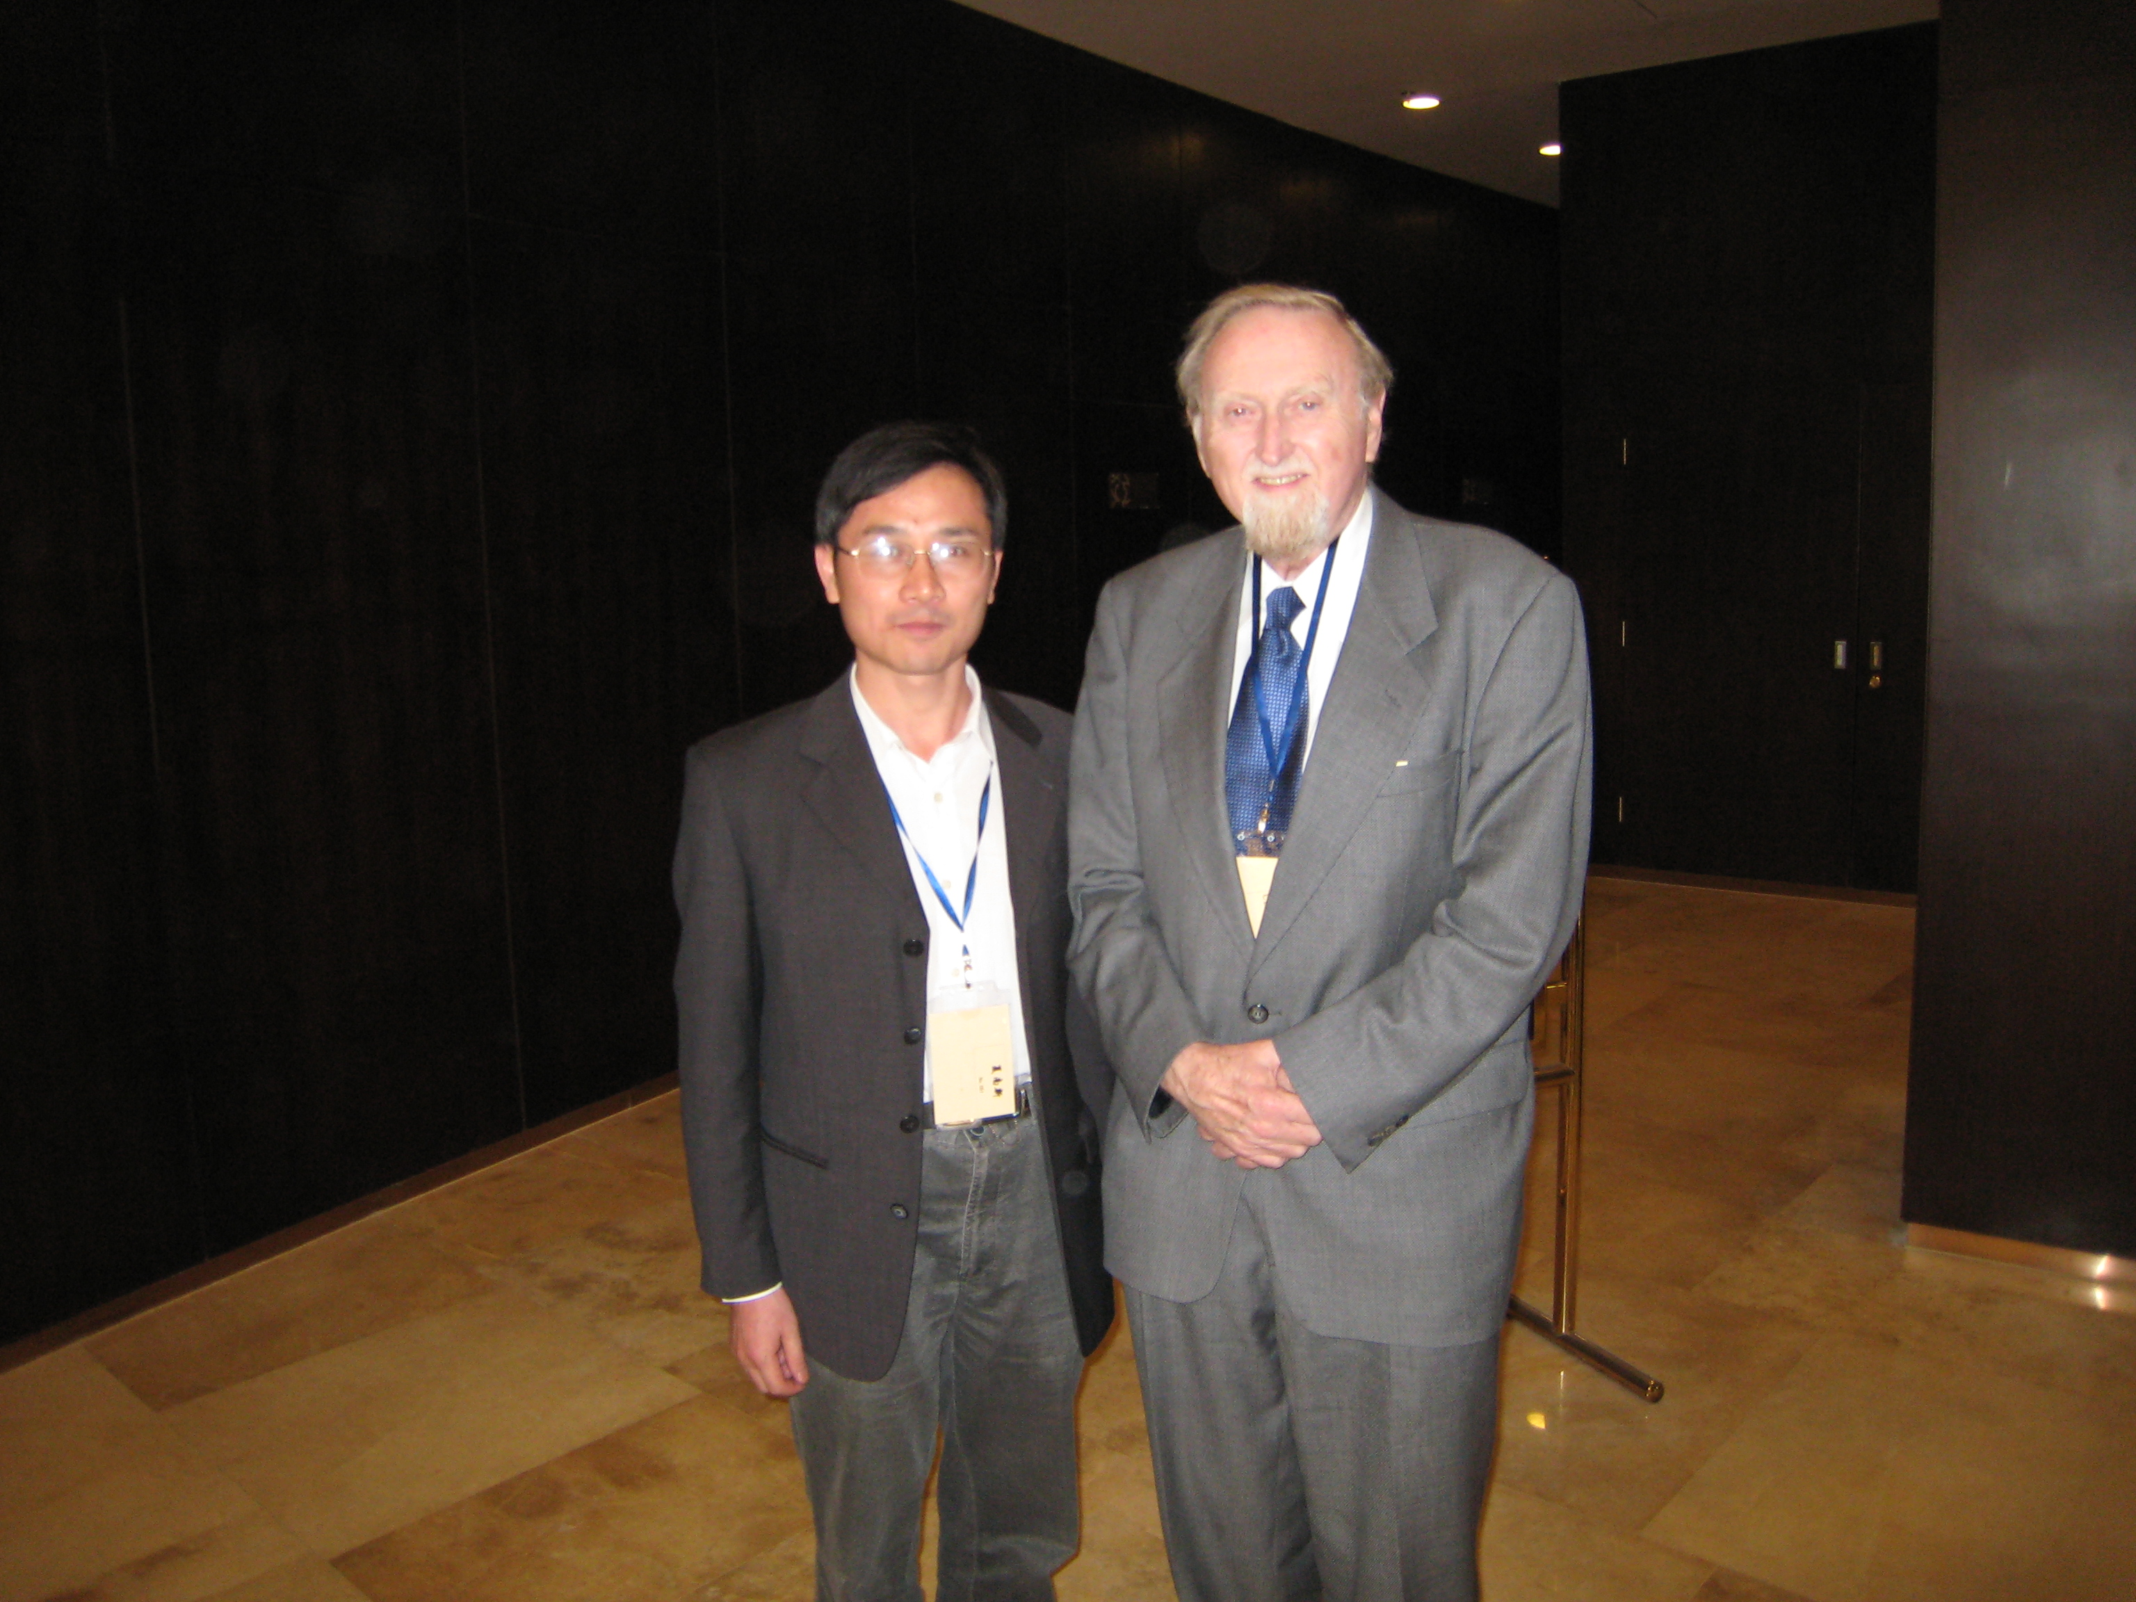

Slide 5


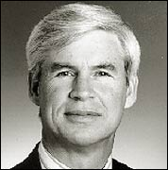
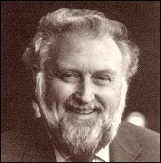
*****Engle, Granger win Nobel Prize for Economics*****
American Robert F Engle and Briton Clive W J Granger on Wednesday won the 2003 Nobel Economics Prize for their work in analysing economic time series.

Slide 6
The Royal Swedish Academy of Sciences decided that the Bank of Sweden Prize in Economic Sciences in Memory of Alfred Nobel, 2003, would be shared between the two for methods of analyzing economic time series with time-varying volatility and for methods of analyzing economic time series with common trends (cointegration).
Robert Engle was born in 1942 in Syracuse, NY, USA (American citizen) and got his Ph.D. from Cornell University in 1969.
He is Michael Armellino Professor of Management of Financial Services at New York University, NY, USA.

Slide 7
Clive W J Granger was born in 1934 in Swansea, Wales (British citizen) and obtained his Ph.D. from University of Nottingham in 1959.
He is emeritus Professor of Economics at University of California at San Diego, USA.
Their research gave economists new tools to evaluate risk by improving analysis of indicators such as economic growth, prices or interest rates over a period of time.
The prize money of 10 million kronor ($1.3 million) will be divided equally between them.

Slide 8
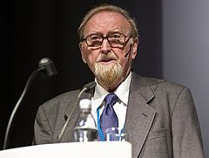
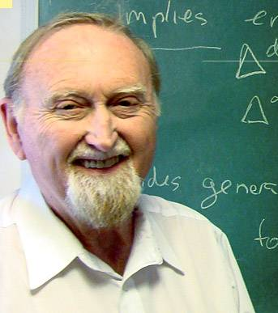
Clive W. J. Granger, 1934-2009
Born: September 4, 1934, Swansea, U.K.
Died: May 27, 2009 (aged 74), San Diego, California, USA

Slide 9
It is with great sadness that I report that Sir Clive Granger passed away last night (2009/6/9). He had been a wonderful colleague and good friend.
Clive always had a particular passion for identifying what was predictable in economic relationships. He emphasized the importance of sorting out which variables are helpful for purposes of forecasting others as one of the first steps in understanding underlying causal relationships.

Slide 10
That philosophy came to be a regular feature in thousands of economic studies and seminars, as scholars would routinely report investigations of “Granger-causality.”
Clive also discovered, in a paper with Paul Newbold published in 1974, the phenomenon of spurious regression. The pair demonstrated by Monte Carlo simulation that if a researcher fails to take account of the underlying dynamics, a regression of one trending variable on another can produce what look like marvelously

Slide 11
significant t-statistics, even though the reality could be that the two series are completely independent of each other.
The key contribution for which Clive was awarded the Nobel Memorial Prize in Economic Sciences in 2003 was his development of the concept of cointegration, a scheme for recognizing and understanding stable relationships in the midst of an otherwise constantly changing economic environment.

Slide 12
Perhaps above all else, Clive was a crucial leader in developing an approach to economic research that is grounded in predictive ability and empirical relations rather than models that theorists find elegant. His influence was an important balancing force for several generations of economists.
I remember him fondly as an amazingly creative individual, always brimming with new ideas, new questions, and new insights. My association with Clive has been a real personal treasure for my career at U.C. San Diego.

Slide 13
Intended Audience
In a wide variety of subject matter areas, data analysis, while interesting with one variable, becomes truly fascinating and challenging when several variables are involved.

Slide 14
Course Objectives
This course covers a variety of topics in the theory and method of Applied Multivariate Statistical Analysis, including arguments for purpose of financial investment decision making and panel data analysis, etc. It aims at not only giving graduates a brief textbook analysis of multivariate statistical issues, but also providing you with vigorous training on research in objective appraisal and effective refinement of multivariate data.

Slide 15
Textbook and Teaching Materials
For background reading, students can use any textbook on applied multivariate statistical analysis for financial investment and economics. One suggestion is the book by Richard A. Johnson & Dean W. Wichern, The Applied Multivariate Statistical Analysis , 5th edition, 2002, Prentice-Hall, Inc.
For most of the course, we focus on the recent lite-rature of time multivariate analysis cases by discu-ssing selected journal articles and working papers.

Slide 16
Requirements and Assessment
Assignments will be given but will not be collected. However, answers to the questio-ns will be provided.
There is one final paper at the end of the semester.
Students are required to do a team project in team. Each team, which will be formed on a voluntary basis, consists of 3 (minim-um) to 5 (maximum) people. Requirements

Slide 17
about the team project will be announced during the middle of the semester. Projects will be presented in a few weeks.
All of teams leading teacher must work on computer by SAS9.0 software in order to deal with lots of data in the Computer Lab of Lingnan Location.

Slide 18
Distribution of Grading
Item Weight (%)
Team Paper 20
Attendance 20
Final Paper 60

Slide 19
Reading List
王学民，（1999），应用多元分析（M），上海财经大学出版社。
高惠璇， (2002)，实用统计方法与SAS系统(M)，北京大学出版社。
The SAS9.0 Handbook.

Slide 20
Preference
Class size: Below 30.
Students with background in Econometrics and Mathematics are preferred.

Slide 21
Brief Course Contents
Weeks Topics/Themes Readings
1-4 Preface & Principal Components Handout
5-8 Factor Analysis and Inference for Reference
Structured Covariance Matrices Books
9-12 Canonical Correlation Analysis Handout
13-15 Discrimination and Classification Materials
16-18 Clustering, Distance Methods,
and Ordination Materials
19-20 Review & Submitting Paper Notes

